Slide 1

Overﬁtting, Underﬁtting
and Cross-Validation
Prof. Mingkui Tan
South China University of Technology
Southern Artificial Intelligence Laboratory(SAIL)

Slide 2
Content
Problem of Model Validation
Underfitting and Overfitting
Bias-Variance Tradeoff
Cross-Validation
Training Data, Validation Data, Testing Data
Performance Report
Parameter Tuning
K-Fold Cross-Validation

Slide 3
Content
Problem of Model Validation
Underfitting and Overfitting
Bias-Variance Tradeoff
Cross-Validation
Training Data, Validation Data, Testing Data
Performance Report
Parameter Tuning
K-Fold Cross-Validation

Slide 4
Why We All Need Validation
Business Reasons
Need to choose the best model.
Measure accuracy/power of selected model.
Good to measure ROI of the modeling project.
Statistical Reasons
Model building techniques are inherently designed to minimize “loss” or “bias”.
To an extent, a model will always fit “noise” as well as “signal”.
➔ If you just fit a bunch of models on a given dataset and choose the “best” one, it will likely be overly “optimistic”.

Slide 5
Some Definitions
Target Variable: Y
What we are trying to predict.
House price,…
Input Variables: {X₁, X₂,… ,X_{N}}
Input features used to make predictions.
Size of house, ….
Predictive Model: Y = f(X₁, X₂,… ,X_{N})
Estimates the unknown value Y based on known values {X_{i}}.

Slide 6
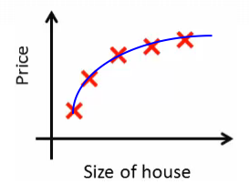
General Fitting Scheme

Slide 7
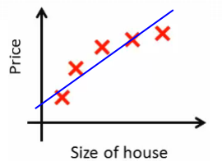
Underﬁtting
Model cannot capture the underlying trend of the data

Slide 8
Solution to Underﬁtting
Model cannot capture the underlying trend of the data

Slide 9
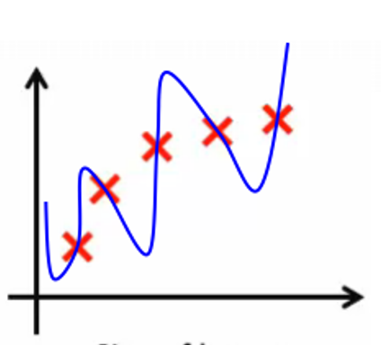
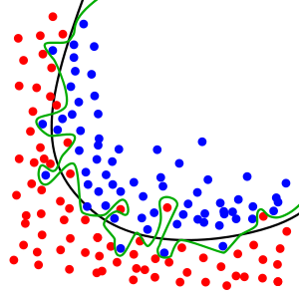
The Problem of Overfitting
Model is too complex to capture the true pattern
Model seeks to fit the noise or outlier of the data

Slide 10
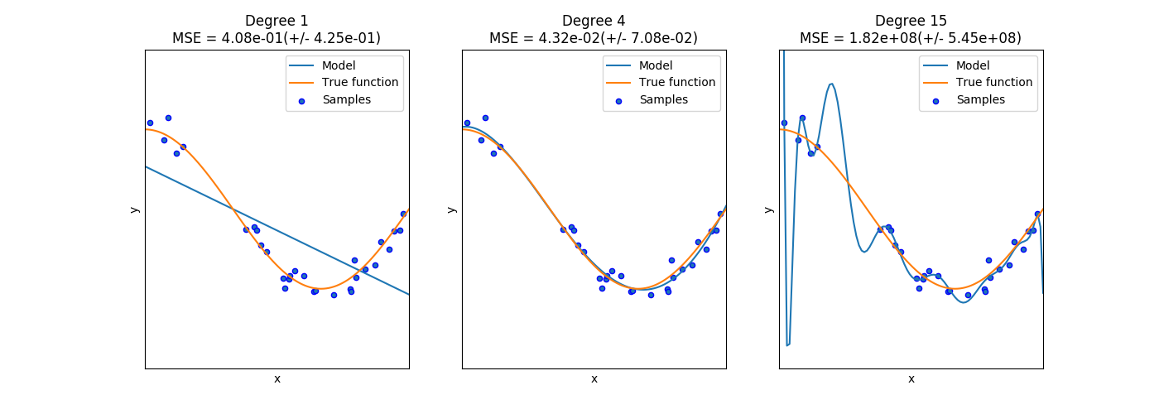
Underfitting vs Overfitting
model seeks to fit the noise or outlier of the data

Slide 11
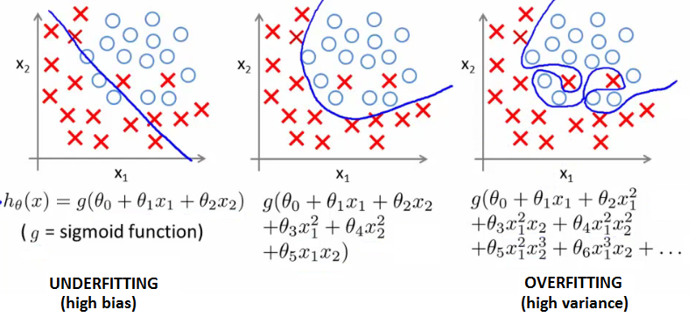
Underfitting vs Overfitting

Slide 12
The Perils of Optimism
Error on the dataset used to fit the model can be misleading
Doesn’t predict future performance.
Too much complexity can diminish model’s accuracy on future data.
Sometimes called the Bias-Variance Tradeoff.

Slide 13
The Bias-Variance Tradeoff
Complex model:
Low “bias”:
The model fit is good on the training data.
The model value is close to the data’s expected value.
High “Variance”:
Model more likely to make a wrong prediction.

Slide 14
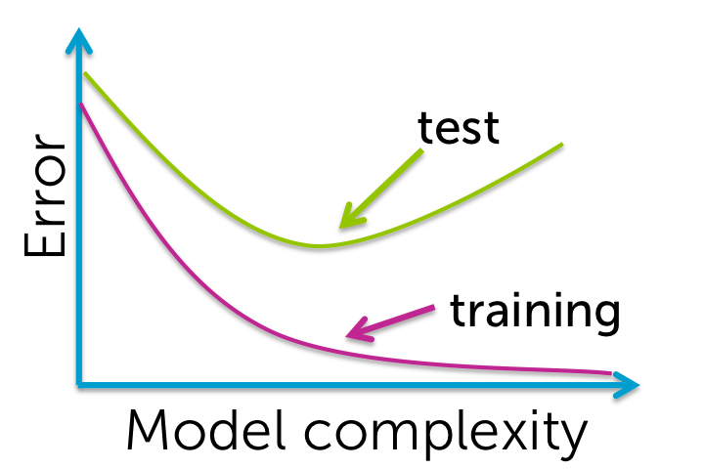
Signs of Underfitting/Overfitting
How do we know if we are underfitting or overfitting?
– If by increasing capacity we decrease generalization error, then we are underfitting, otherwise we are overfitting.
– If the error in representing the training set is relatively large and the generalization error is large, then underfitting;

Slide 15
Signs of Underfitting/Overfitting
Need to increase capacity (complexity of models).
– If the error in representing the training set is relatively small and the generalization error is large, then overfitting;
Need to decrease capacity or increase training set.
– Many features and relatively small training set.
– if you have chosen a large capacity to complement the many features, then you might overfit the data:
need to decrease the capacity.

Slide 16
Content
Problem of Model Validation
Underfitting and Overfitting
Bias-Variance Tradeoff
Cross-Validation
Training Data, Validation Data, Testing Data
Performance Report
Parameter Tuning
K-Fold Cross-Validation

Slide 17


Data Split
Training data
Testing data
Data provider
Keep secret!
Data user
Simplest idea: Divide data into 2 pieces.
Training data: data used to fit model
Test data: “fresh” data used to evaluate model
Test data contains:
Actual target value Y
Model prediction Y*
We can find clever ways of displaying the relation between Y and Y*.
Lift curves, gains charts, ROC curves ……

Slide 18
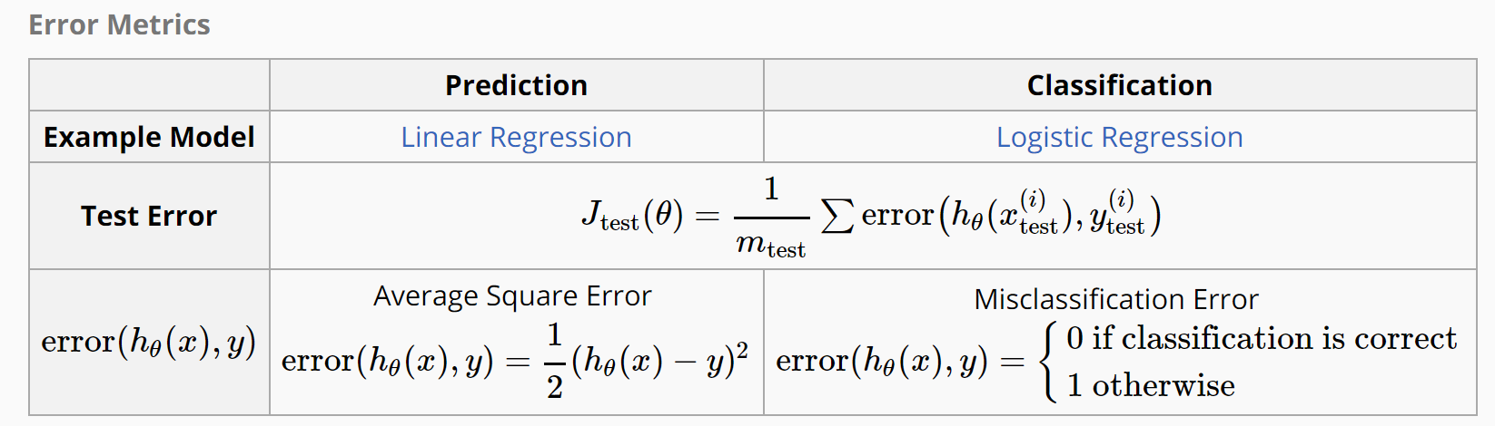
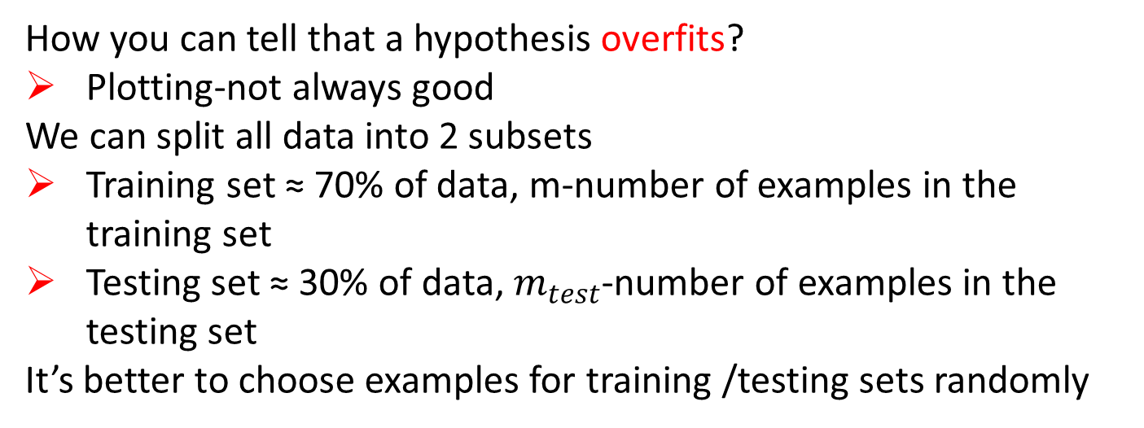
Testing Errors
How you can tell that a hypothesis overfits?
Plotting-not always good
We can split all data into 2 subsets
Training set ≈ 70% of data, m-number of examples in the training set
Testing set ≈ 30% of data, $m_{test}$-number of examples in the testing set
It’s better to choose examples for training /testing sets randomly

Slide 19

Validation
Testing data
Keep secret!
Training data
Training data
Data provider
Validation data
Data user
Generally cross-validation is used to find the best value of some parameter
We still have training and testing sets
But additionally we have a cross-validation set to test the performance of our model depending on the parameter

Slide 20
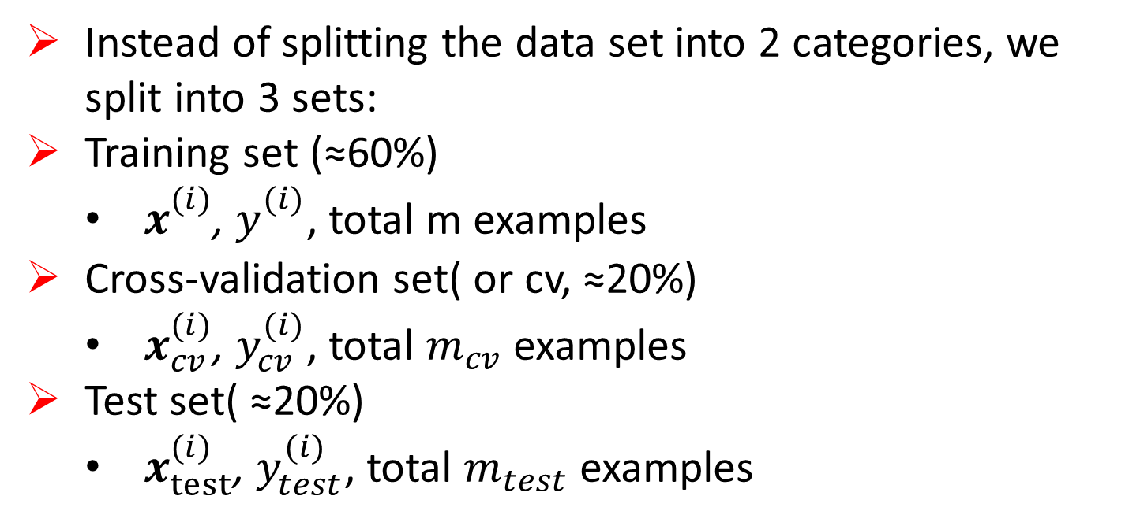
Cross-Validation for Evaluation
Instead of splitting the data set into 2 categories, we split into 3 sets:
Training set (≈60%)
$x_{}^{(i)}$, $y_{}^{(i)}$, total m examples
Cross-validation set( or cv, ≈20%)
$x_{cv}^{(i)}$, $y_{cv}^{(i)}$, total $m_{cv}$ examples
Test set( ≈20%)
$x_{test}^{(i)}$, $y_{test}^{(i)}$, total $m_{test}$ examples

Slide 21
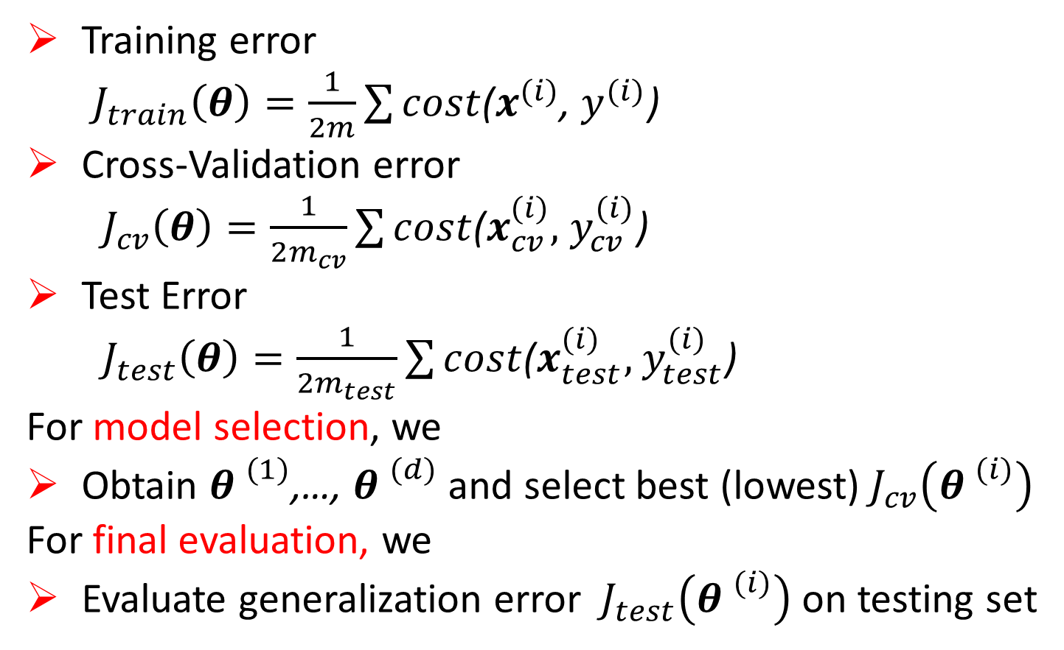
Cross-Validation for Evaluation
Training error
${ J}_{train}\left(θ\right)=\frac{1}{2m}\sum{cost}$($x^{(i)}$, $y^{(i)}$)
Cross-Validation error
${ J}_{cv}\left(θ\right)=\frac{1}{2m_{cv}}\sum{cost}$($x_{cv}^{(i)},$ $y_{cv}^{(i)}$)
Test Error
${ J}_{test}\left(θ\right)=\frac{1}{2m_{test}}\sum{cost}$($x_{test}^{(i)},$ $y_{test}^{(i)}$)
For model selection, we
Obtain ${θ }^{(1)}$,…, ${θ }^{(d)}$ and select best (lowest)${ J}_{cv}\left({θ }^{(i)}\right)$
For final evaluation, we
Evaluate generalization error ${ J}_{test}\left({θ }^{(i)}\right)$on testing set

Slide 22

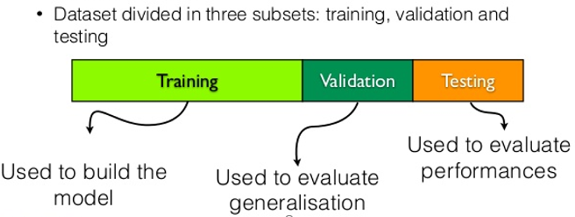
Tuning Learning Parameter
Testing data
Keep secret!
Training data
Training data
Data provider
Validation data
Data user
Split data set into
Learning set
Validation set
Test set
Use validation set for tuning hyper-parameters
Use testing set only for final evaluation

Slide 23
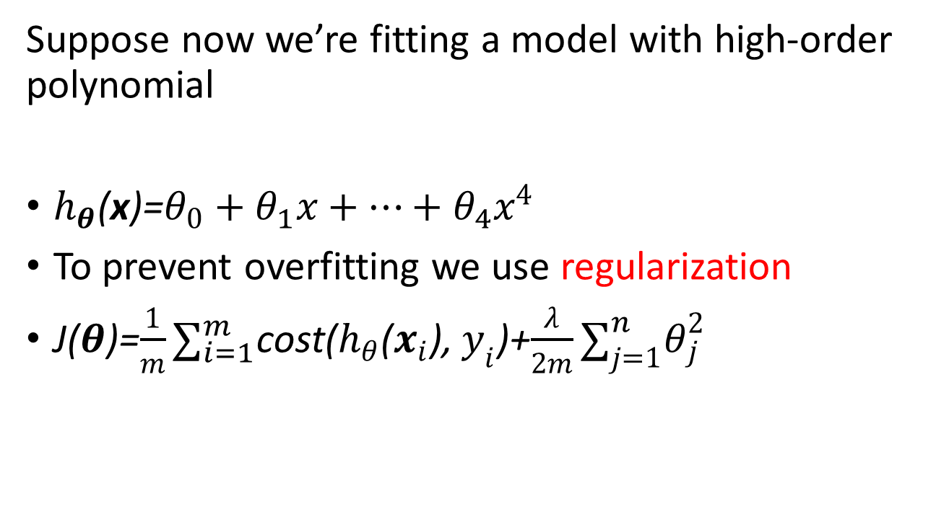
Example: Tuning Regularization Parameter λ
Suppose now we’re fitting a model with high-order polynomial
$h_{θ}$(x)=$θ_{0}+θ_{1}x+…+θ_{4}x^{4}$
To prevent overfitting we use regularization
J($θ$)=$\frac{1}{m}∑_{i=1}^{m}$cost($h_{θ}$($x_{i}$), $y_{i}$)+$\frac{λ}{2m}∑_{j=1}^{n}θ_{j}^{2}$

Slide 24
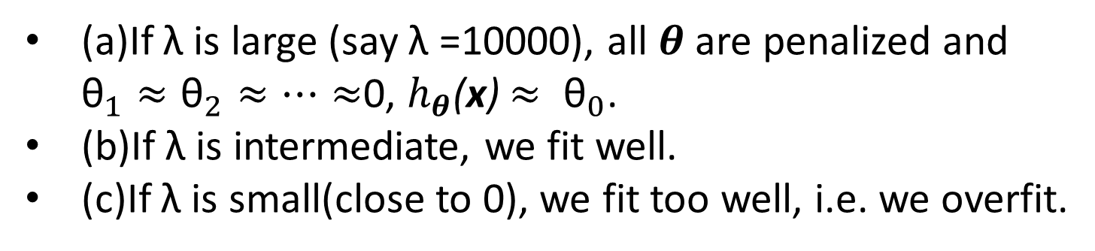
Regularization Parameter λ
(a)
(b)
(c)
(a)If λ is large (say λ =10000), all $θ$ are penalized and ${\text{θ}}_{1}≈{\text{θ}}_{2}≈…≈$0, $h_{θ}$(x) $≈ {\text{θ}}_{0}$.
(b)If λ is intermediate, we fit well.
(c)If λ is small(close to 0), we fit too well, i.e. we overfit.

Slide 25
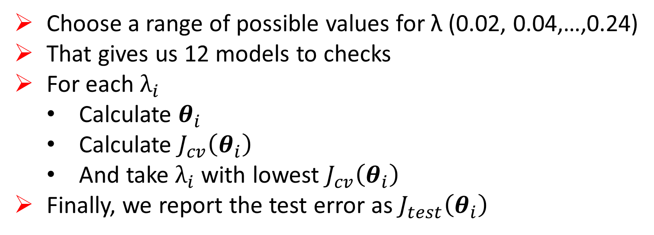
Chose good λ on validation set
Choose a range of possible values for λ (0.02, 0.04,…,0.24)
That gives us 12 models to checks
For each $λ_{i}$
Calculate $θ_{i}$
Calculate $J_{cv}\left(θ_{i}\right)$
And take $λ_{i}$ with lowest $J_{cv}\left(θ_{i}\right)$
Finally, we report the test error as $J_{test}\left(θ_{i}\right)$

Slide 26
K-Fold Cross-Validation
If we want to reduce variability in the data
We can use multiple rounds of cross-validation using different partitions
And then average the result over all rounds
We’re given a dataset S sampled from the population D
k= 1 2 3 4 5 6 7 8 9 10
3rd fold validation set

Slide 27
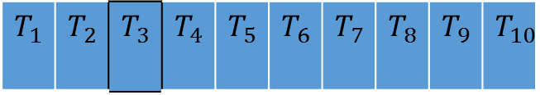
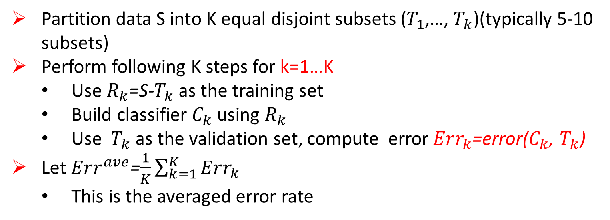
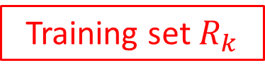
K-Fold Cross-Validation
$$T_{1}$$ | $$T_{2}$$ | $$T_{3}$$ | $$T_{4}$$ | $$T_{5}$$ | $$T_{6}$$ | $$T_{7}$$ | $$T_{8}$$ | $$T_{9}$$ | $$T_{10}$$
K=10, step k=3:
validation set
Training set $R_{k}$
Partition data S into K equal disjoint subsets ($T_{1}$,…, $T_{k}$)(typically 5-10 subsets)
Perform following K steps for k=1…K
Use $R_{k}$=S-$T_{k}$ as the training set
Build classifier $C_{k}$ using $R_{k}$
Use $T_{k}$ as the validation set, compute error${ Err}_{k}$=error($C_{k}$, $T_{k}$)
Let ${Err}^{ave}$=$\frac{1}{K}\sum_{k=1}^{K}{{Err}_{k}}$
This is the averaged error rate

Slide 28
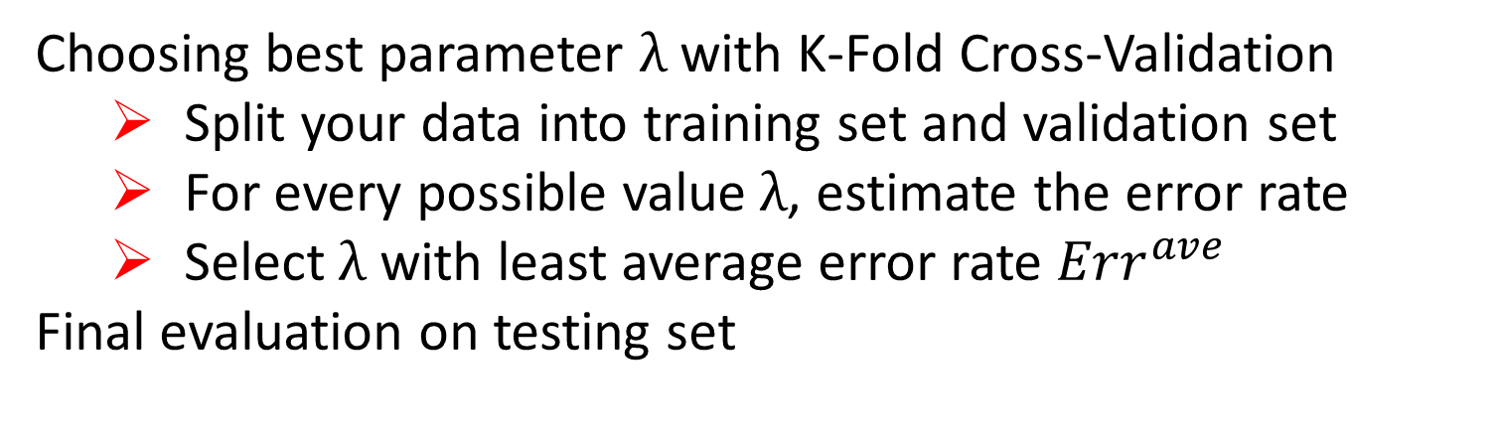
Tuning Learning Parameter
Choosing best parameter $λ$ with K-Fold Cross-Validation
Split your data into training set and validation set
For every possible value$λ$, estimate the error rate
Select $λ$ with least average error rate ${Err}^{ave}$
Final evaluation on testing set

